Slide 1
Digital Design & Computer Arch. Lecture 7a: Sequential Logic Design II
Prof. Onur Mutlu
ETH Zürich
Spring 2020
12 March 2020

Slide 2
Agenda for This Week
Today
Wrap up Sequential Logic
Hardware Description Languages and Verilog
Combinational Logic
Sequential Logic
Tomorrow
Timing and Verification

Slide 3
Agenda for Next Week
Thursday
Von Neumann Model of Execution
Instruction Set Architecture
LC-3 and MIPS
Friday
ISA and Assembly Programming

Slide 4
Assignment: Required Lecture Video
Why study computer architecture?
Why is it important?
Future Computing Architectures
Required Assignment
Watch Prof. Mutlu’s inaugural lecture at ETH and understand it
https://www.youtube.com/watch?v=kgiZlSOcGFM
Optional Assignment – for 1% extra credit
Write a 1-page summary of the lecture and email us
What are your key takeaways?
What did you learn?
What did you like or dislike?
Submit your summary to Moodle – Deadline: April 1

Slide 5
Extra Assignment: Moore’s Law (I)
Paper review
G.E. Moore. "Cramming more components onto integrated circuits," Electronics magazine, 1965
Optional Assignment – for 1% extra credit
Write a 1-page review
Upload PDF file to Moodle – Deadline: April 1
I strongly recommend that you follow my guidelines for (paper) review (see next slide)

Slide 6
Extra Assignment: Moore’s Law (II)
Guidelines on how to review papers critically
Guideline slides: pdf ppt
Video: https://www.youtube.com/watch?v=tOL6FANAJ8c
Example reviews on “Main Memory Scaling: Challenges and Solution Directions” (link to the paper)
Review 1
Review 2
Example review on “Staged memory scheduling: Achieving high performance and scalability in heterogeneous systems” (link to the paper)
Review 1

Slide 7
Required Readings (This Week)
Hardware Description Languages and Verilog
H&H Chapter 4 in full
Timing and Verification
H&H Chapters 2.9 and 3.5 + (start Chapter 5)
By tomorrow, make sure you are done with
P&P Chapters 1-3 + H&H Chapters 1-4

Slide 8
Required Readings (Next Week)
Von Neumann Model, LC-3, and MIPS
P&P, Chapters 4, 5
H&H, Chapter 6
P&P, Appendices A and C (ISA and microarchitecture of LC-3)
H&H, Appendix B (MIPS instructions)
Programming
P&P, Chapter 6
Recommended: Digital Building Blocks
H&H, Chapter 5

Slide 9
Wrap-Up Sequential Logic Circuits and Design

Slide 10
Finite State Machine: Schematic

Slide 11
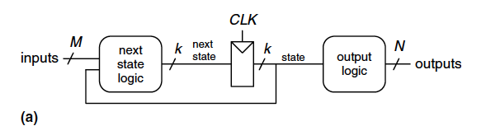
FSM Schematic: State Register

Slide 12
FSM Schematic: State Register

Slide 13
FSM Schematic: Next State Logic
S’₁ = S₁ xor S₀
S’₀ = (S₁ ∙ S₀ ∙ T_{A}) + (S₁ ∙ S₀ ∙ T_{B})

Slide 14
FSM Schematic: Output Logic
L_{A1} = S₁
L_{A0} = S₁ ∙ S₀
L_{B1} = S₁
L_{B0} = S₁ ∙ S₀

Slide 15
FSM Timing Diagram
T_{A}
Reset
__
S0
L_{A}: yellow
L_{B}: red
T_{A}
S1
L_{A}: yellow
L_{B}: red
S3
L_{A}: red
L_{B}: yellow
S2
L_{A}: red
L_{B}: green
__
T_{B}
T_{B}

Slide 16
FSM Timing Diagram
T_{A}
Reset
__
S0
L_{A}: yellow
L_{B}: red
T_{A}
S1
L_{A}: yellow
L_{B}: red
S3
L_{A}: red
L_{B}: yellow
S2
L_{A}: red
L_{B}: green
__
T_{B}
T_{B}

Slide 17
FSM Timing Diagram
T_{A}
Reset
__
S0
L_{A}: yellow
L_{B}: red
T_{A}
S1
L_{A}: yellow
L_{B}: red
S3
L_{A}: red
L_{B}: yellow
S2
L_{A}: red
L_{B}: green
__
T_{B}
T_{B}

Slide 18
FSM Timing Diagram
T_{A}
Reset
__
S0
L_{A}: yellow
L_{B}: red
T_{A}
S1
L_{A}: yellow
L_{B}: red
S3
L_{A}: red
L_{B}: yellow
S2
L_{A}: red
L_{B}: green
__
T_{B}
T_{B}

Slide 19
FSM Timing Diagram
T_{A}
Reset
__
S0
L_{A}: yellow
L_{B}: red
T_{A}
S1
L_{A}: yellow
L_{B}: red
S3
L_{A}: red
L_{B}: yellow
S2
L_{A}: red
L_{B}: green
__
T_{B}
T_{B}

Slide 20
FSM Timing Diagram
T_{A}
Reset
__
S0
L_{A}: yellow
L_{B}: red
T_{A}
S1
L_{A}: yellow
L_{B}: red
S3
L_{A}: red
L_{B}: yellow
S2
L_{A}: red
L_{B}: green
__
T_{B}
T_{B}

Slide 21
FSM Timing Diagram
T_{A}
Reset
__
S0
L_{A}: yellow
L_{B}: red
T_{A}
S1
L_{A}: yellow
L_{B}: red
S3
L_{A}: red
L_{B}: yellow
S2
L_{A}: red
L_{B}: green
__
T_{B}
T_{B}

Slide 22
FSM Timing Diagram
T_{A}
Reset
__
S0
L_{A}: yellow
L_{B}: red
T_{A}
S1
L_{A}: yellow
L_{B}: red
S3
L_{A}: red
L_{B}: yellow
S2
L_{A}: red
L_{B}: green
__
T_{B}
This is from H&H Section 3.4.1
T_{B}

Slide 23
FSM Timing Diagram
T_{A}
Reset
__
S0
L_{A}: yellow
L_{B}: red
T_{A}
S1
L_{A}: yellow
L_{B}: red
S3
L_{A}: red
L_{B}: yellow
S2
L_{A}: red
L_{B}: green
__
T_{B}
T_{B}

Slide 24
FSM Timing Diagram
T_{A}
Reset
__
S0
L_{A}: yellow
L_{B}: red
T_{A}
S1
L_{A}: yellow
L_{B}: red
See H&H Chapter 3.4
S3
L_{A}: red
L_{B}: yellow
S2
L_{A}: red
L_{B}: green
__
T_{B}
T_{B}

Slide 25
Finite State Machine: State Encoding

Slide 26
FSM State Encoding
How do we encode the state bits?
Three common state binary encodings with different tradeoffs
Fully Encoded
1-Hot Encoded
Output Encoded
Let’s see an example Swiss traffic light with 4 states
Green, Yellow, Red, Yellow+Red

Slide 27
FSM State Encoding (II)
Binary Encoding (Full Encoding):
Use the minimum number of bits used to encode all states
Use log₂(num_states) bits to represent the states
Example states: 00, 01, 10, 11
Minimizes # flip-flops, but not necessarily output logic or next state logic
One-Hot Encoding:
Each bit encodes a different state
Uses num_states bits to represent the states
Exactly 1 bit is “hot” for a given state
Example states: 0001, 0010, 0100, 1000
Simplest design process – very automatable
Maximizes # flip-flops, minimizes next state logic

Slide 28
FSM State Encoding (III)
Output Encoding:
Outputs are directly accessible in the state encoding
For example, since we have 3 outputs (light color), encode state with 3 bits, where each bit represents a color
Example states: 001, 010, 100, 110
Bit₀ encodes green light output,
Bit₁ encodes yellow light output
Bit₂ encodes red light output
Minimizes output logic
Only works for Moore Machines (output function of state)

Slide 29
FSM State Encoding (III)
Output Encoding:
Outputs are directly accessible in the state encoding
For example, since we have 3 outputs (light color), encode state with 3 bits, where each bit represents a color
Example states: 001, 010, 100, 110
Bit₀ encodes green light output,
Bit₁ encodes yellow light output
Bit₂ encodes red light output
Minimizes output logic
Only works for Moore Machines (output function of state)
The designer must carefully choose
an encoding scheme to optimize the design under given constraints

Slide 30
Moore vs. Mealy Machines

Slide 31
Recall: Moore vs. Mealy FSMs
Next state is determined by the current state and the inputs
Two types of finite state machines differ in the output logic:
Moore FSM: outputs depend only on the current state
Mealy FSM: outputs depend on the current state and the inputs

Slide 32
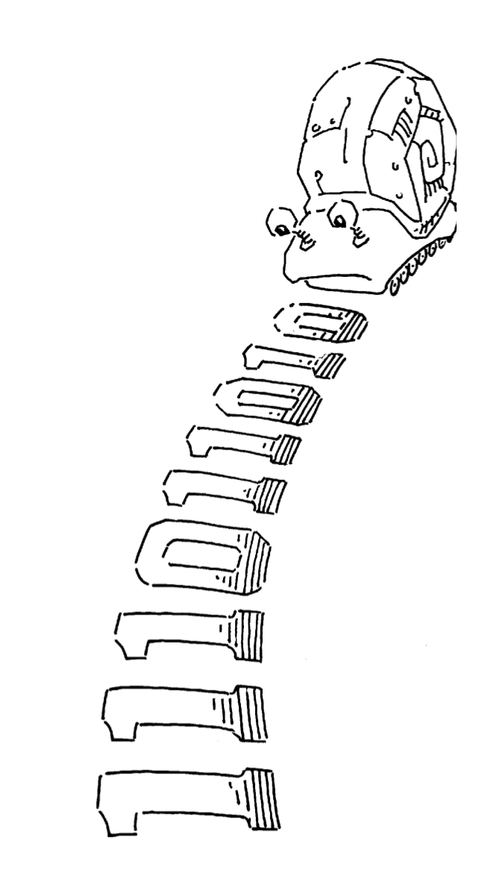
Moore vs. Mealy FSM Examples
Alyssa P. Hacker has a snail that crawls down a paper tape with 1’s and 0’s on it.
The snail smiles whenever the last four digits it has crawled over are 1101.
Design Moore and Mealy FSMs of the snail’s brain.

Slide 33
Moore vs. Mealy FSM Examples
Alyssa P. Hacker has a snail that crawls down a paper tape with 1’s and 0’s on it.
The snail smiles whenever the last four digits it has crawled over are 1101.
Design Moore and Mealy FSMs of the snail’s brain.

Slide 34
State Transition Diagrams
What are the tradeoffs?

Slide 35
FSM Design Procedure
Determine all possible states of your machine
Develop a state transition diagram
Generally this is done from a textual description
You need to 1) determine the inputs and outputs for each state and 2) figure out how to get from one state to another
Approach
Start by defining the reset state and what happens from it – this is typically an easy point to start from
Then continue to add transitions and states
Picking good state names is very important
Building an FSM is like programming (but it is not programming!)
An FSM has a sequential “control-flow” like a program with conditionals and goto’s
The if-then-else construct is controlled by one or more inputs
The outputs are controlled by the state or the inputs
In hardware, we typically have many concurrent FSMs

Slide 36
What is to Come: LC-3 Processor

Slide 37
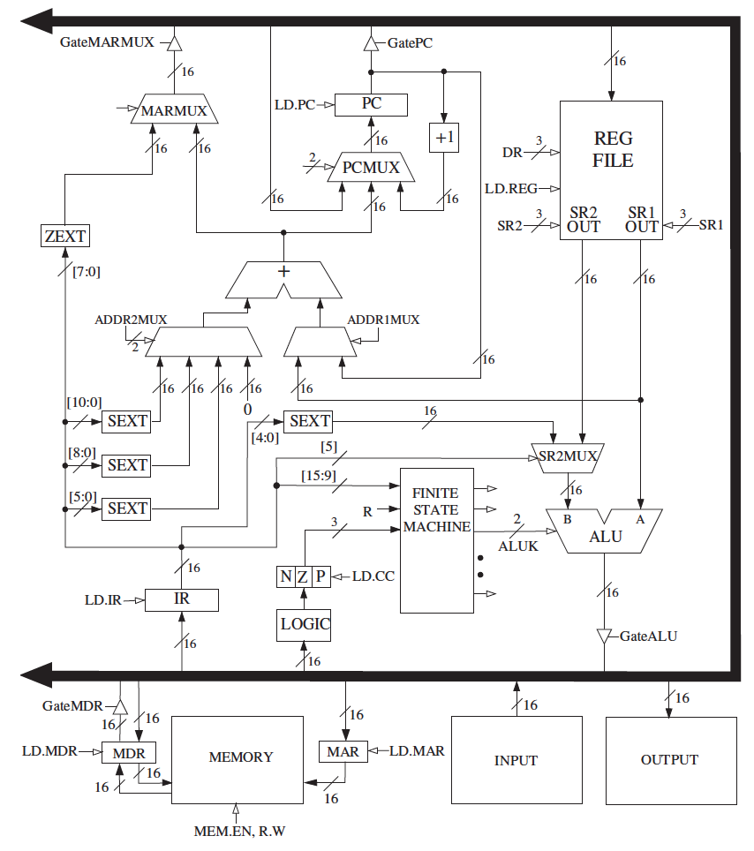
What is to Come: LC-3 Datapath

Slide 38
Digital Design & Computer Arch. Lecture 7a: Sequential Logic Design II
Prof. Onur Mutlu
ETH Zürich
Spring 2020
12 March 2020

